Slide 1

The Minitel
for « Médium interactif par numérisation d'information téléphonique » [FR]
Or Interactive medium by phone numerisation of information [EN]

Slide 2
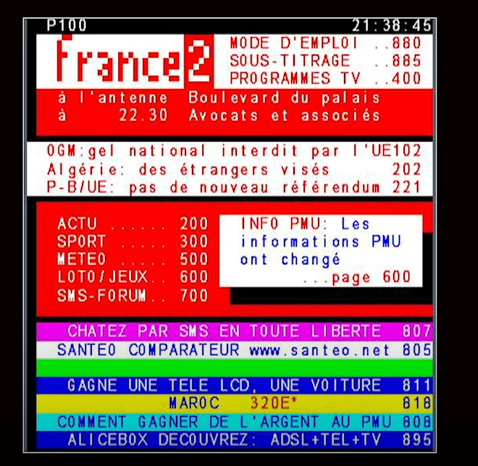
The beginning
The team in charge of creating the Minitel was first in charge of the Teletext for France

Slide 3

The beginning
This communication technology was created by the Post, Telegraph and Telecommunication

Slide 4
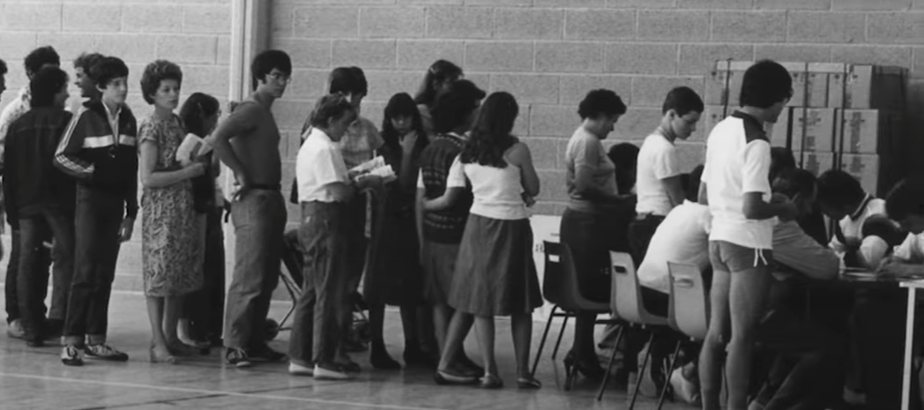
The beginning
It was created in 1980 and tested at St-Malo
« Commercialised » in 1981

Slide 5
Fun fact !
It was FREE* !!!
*I was but only for those who had a phone subscription and the cost was 0.34€ per minute (basic) up to 1 € (36.15)

Slide 6
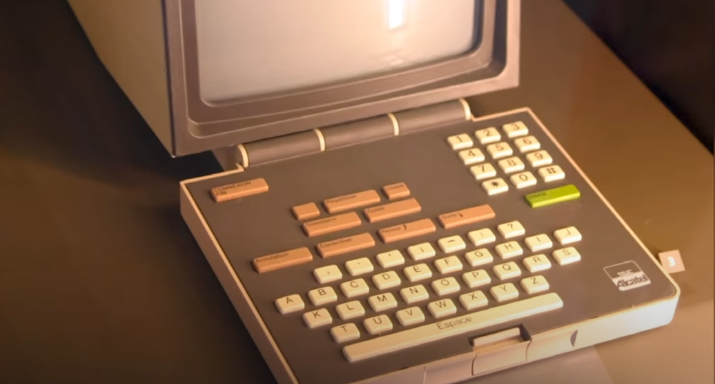
Fun fact !
At first the Keyboard was and « ABCDEF » one…

Slide 7

Fun fact !
50 % of The Minitel usage was for “Booty-calls” (telephone rose) in 1990…

Slide 8
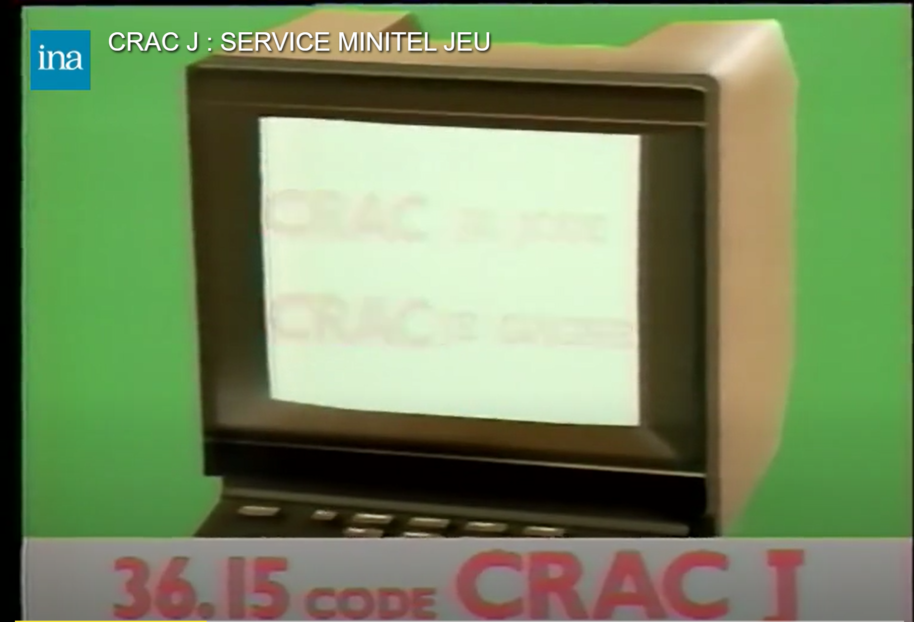
WE WANT GAMES !!
Some game were developed for the Minitel…

Slide 9

Best year for Minitel !
The peak of usage was in 1993

Slide 10
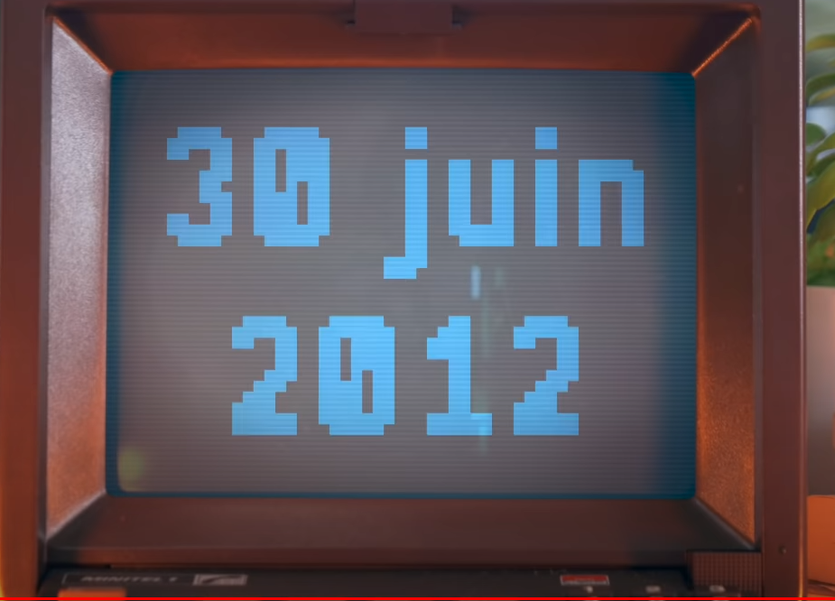
The «death» of Minitel
With Internet, the Minitel stopped being successful in the early 2000
It’s only the 30th of June 2012 that it was stopped with the Teletel network being put down by France Telecom.

Slide 11
Thank you for listenning !
https://www.youtube.com/watch?v=oPcYNWqKuB0
← For more info

